Slide 1
A Project Presentation on
“IoT based Mini-Elevator for Transferring Light Weight Stuffs in multistorey buildings “
Submitted by
Mr. Shubham Chandrakant Avatade Mr. Akash Prabhakar Agawane Mr. Rahil Santosh Gangwal Mr. Nemat Mahamud Sache
Under the Guidance of Dr. S. B. Tuljapure Department of Mechanical Engineering Walchand Institute of Technology, Solapur

Slide 2
Need of the Work:
Here we aimed to design an IoT based mini elevator which can supply the material up to 5 kg to any floor of the apartments and can save the energy as well as time.
We have made survey in metro cities, there also at most of the areas IoT concept is not used till date.
If milkman or anyone wants to supply their products so either he or she needs to go their by stairs or use lift of the apartment or owner has to come downside. In some cases apartments lift is not being utilized for this work, so it is complicated procedure.
In law there is one condition that if the apartment is 5 or less storey so it is not necessary to build lifts.
Due to such reasons this activity is very effort taking and time consuming.
So if we use this IoT based mini elevator in such areas it will save energy as well as time .It also allows proper utilization of resources.
This is very useful for skyscraper buildings as well as buildings where apartment lift is not available.

Slide 3
OBJECTIVE:
To design an IoT based mini-elevator.
To carry out finite element analysis of few necessary parts.
To Manufacture and test the model

Slide 4
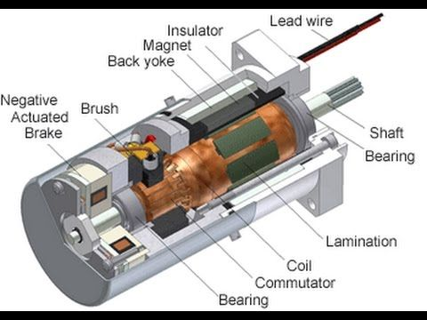
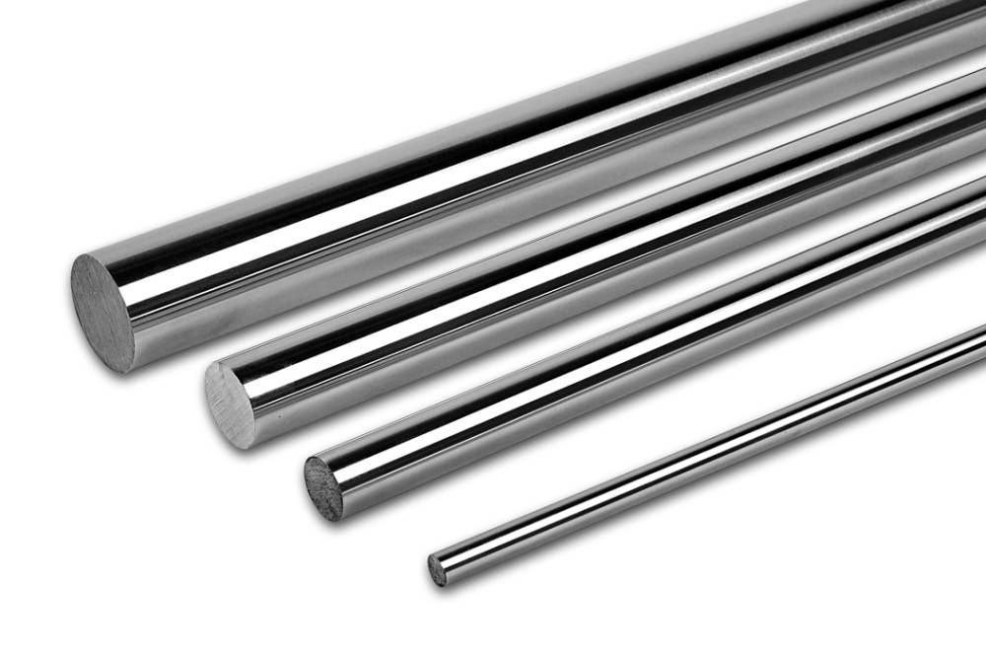
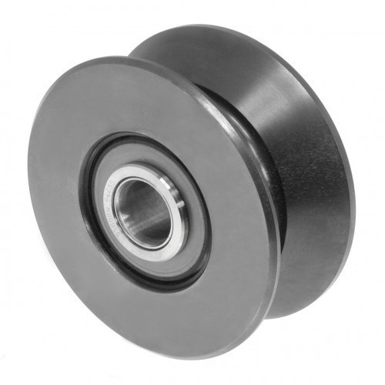
COMPONENTS:
A . Mechanical Components
1. DC Motor 2. Shaft
3. Pulley 4. Rope And Carrier

Slide 5
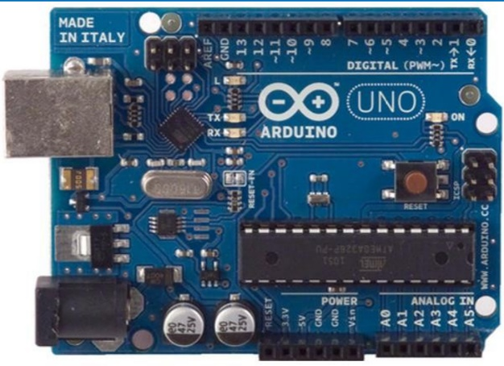
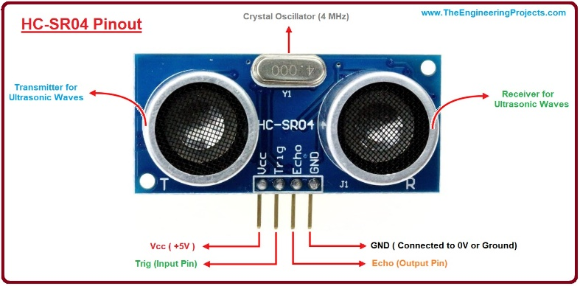
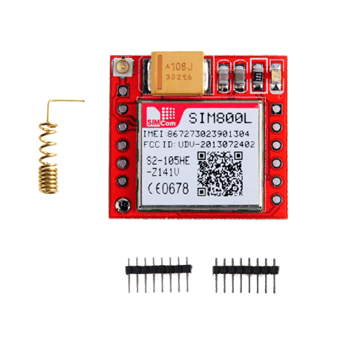
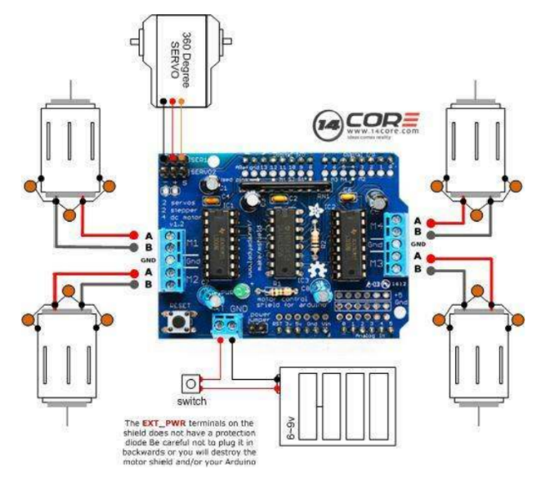
B. Electrical Components
1. Arduino UNO 2. Ultrasonic Sensor
3. Motor Driver 4. GSM 800L

Slide 6
COMPONENTS SPECIFICATIONS:
Motor:
Type- AC geared motor (For actual design)
DC Motor (for model)
RPM- 30
Power- 0.25KW (by considering power transmission losses in gear box)
Pulley:
Diameter- 0.3m
Material- Cast Iron
Key:
Dimensions- 6*6mm(square key)
Material- mild-steel
Rope:
Material- High carbon steel wire
Tensile Strength- 1370 N/mm²
Coating- Galvanized wire
Carrier:
Dimensions- 30cm * 20cm * 20cm
Material- Stainless steel

Slide 7
WORKING PRINCIPLE:
When sender presses switch of the required floor number arduino program gets activated
as Arduino is connected to GSM800L in which sim card is inserted, which sends text message to flat owner.
parallelly Arduino is also connected to motor driver, as soon as the switch gets pressed, IC of motor driver gets activated and motor starts rotating in one direction and carrier starts moving in upward direction.
As carrier moves in upward direction ultrasonic sensor senses the position of carrier when the carrier reaches the required floor number it stops.
Message is already sent to flat owner so he/she will come and takes the parcel and presses the button which allotted to that floor .So signal get sent to motor driver and motor rotates in opposite direction, due to which carrier comes in downward direction.
While moving downward also ultrasonic sensor senses the position of carrier .
When carrier reaches on ground floor it stops.
The same procedure is repeated for next cycle.

Slide 8
DESIGN CALCULATIONS:
General speed of elevator = 0.5 m/sec
Factor of safety = 1.5
Design weight = 10 kg
Considering diameter of pulley = 0.3 m
Force = 15*9.81
= 147.15 N (nearly equal to )
=150 N
Work = Force * displacement
Power = work / Time
= ( Force * Displacement ) /Time
Power = Force * speed
= 150*0.5
= 75 Watt

Slide 9
DESIGN CALCULATIONS:
We know by formula ,
V = ( π * D *N ) /60
0.5 = ( 3.142 * 0.3 * N ) / 60
N = ( 0.5 * 60 ) / ( 3.142 * 0.3 )
N = 30 rpm

Slide 10
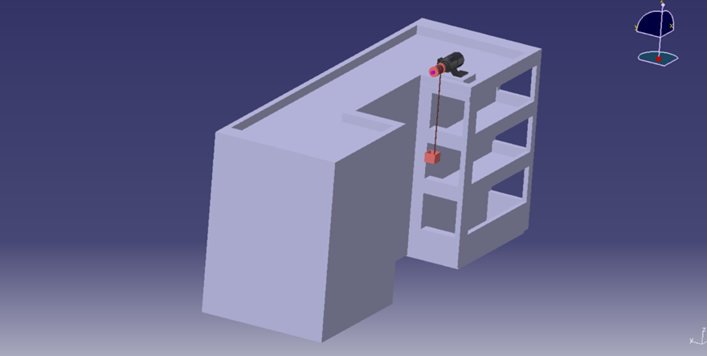
CATIA MODEL:

Slide 11
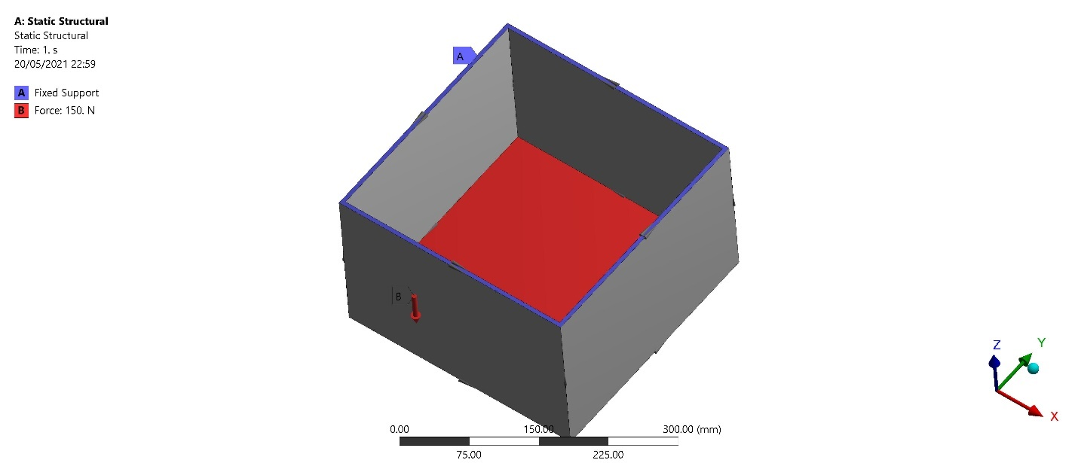
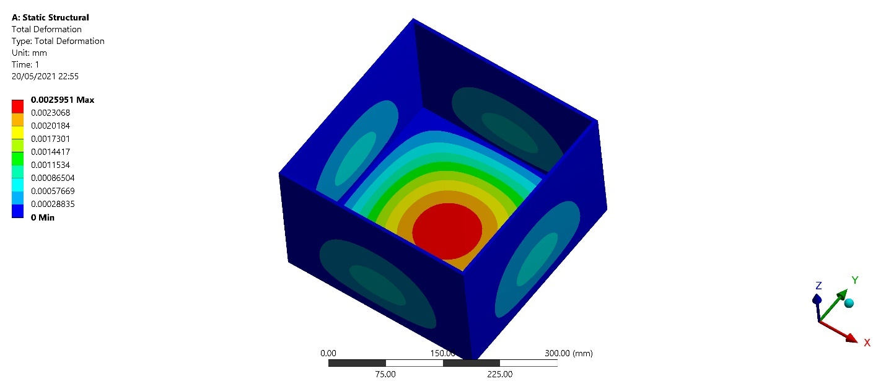
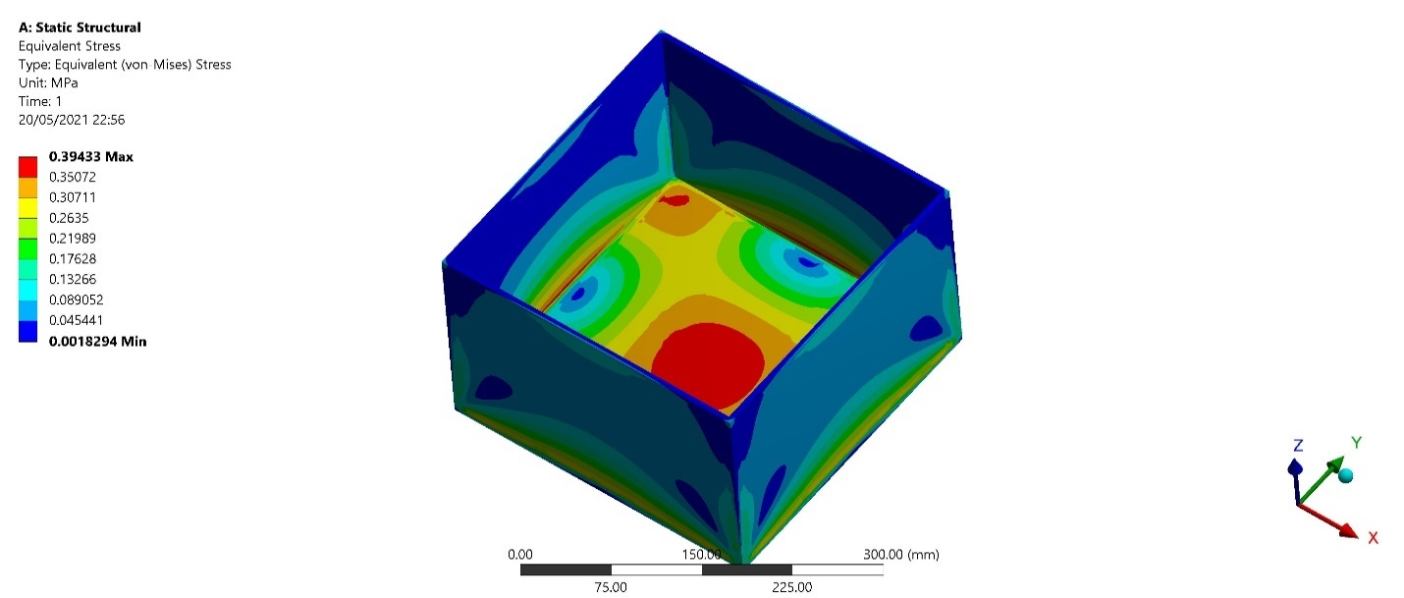
ANALYSIS:
Fig. Boundary Condition
Fig. Total Deformation
Fig. Equivalent Stress

Slide 12
MODEL :

Slide 13
RESULTS:
Ansys analysis shows very low percentage of deformation i.e. design is safe.
Ultrasonic sensor is properly working and lift is stopping at exact location.
Messages are sent on time i.e. before the lift reaches at that floor.
As motor is rotating in both the directions , motor drivers are working properly.
All the electronic components mounted on PCB are properly working
Motor is working in well condition for different loads.

Slide 14
ADVANTAGES:
It saves time as well as efforts.
Easy to maintain and use.
Low cost.
It saves energy.
In Pandemic like Covid, products are delivered in safe manner.
LIMITATIONS:
High weighted objects can’t be transferred.
Structure of project mostly depends on the structure of buildings or apartments.
Safety is not provided in case of rope failure.

Slide 15
APPLICATIONS:
To send small objects like newspaper, milk bags.
To send groceries upto 5 kg.
To send parcel which ordered from online sources i.e. from Zomato, amazon etc.
To send currier which ordered.
Any equipment or product upto 5 kg.

Slide 16
CONCLUSION:
The proposed system will -
Eliminate movement of human being required for transferring low weight stuffs to different floors.
Save time and energy required to lift low weight stuffs.
Reduce strain on hands due to load.
FUTURE SCOPE:
• Mechanism can be made in such a way that if flat owner doesn't respond carrier will tilt and throw products in balcony.
• Guide ways can be provided to carrier.

Slide 17
Thank you

